Slide 1
DATA STRUCTURES & ALGORITHMS
By: Manoja Weerasekara

Slide 2
Session Plan
Session | Module Content
Session 01 | Introduction to Data structures and algorithms
Session 02/03 | Stacks
Session 03/04 | Queues
Session 05/06 | Linear and Binary Search
Session 07 | Sorting Algorithms: Simple
Session 08/09 | Sorting Algorithms: Advance
Session 10 | Time complexity analysis (Big O notation)
Session 11 | Recursion
Session 12 | Linked Lists
Session 13/14 | Tree Concepts, Tree Traversal, Binary Search Tree

Slide 3
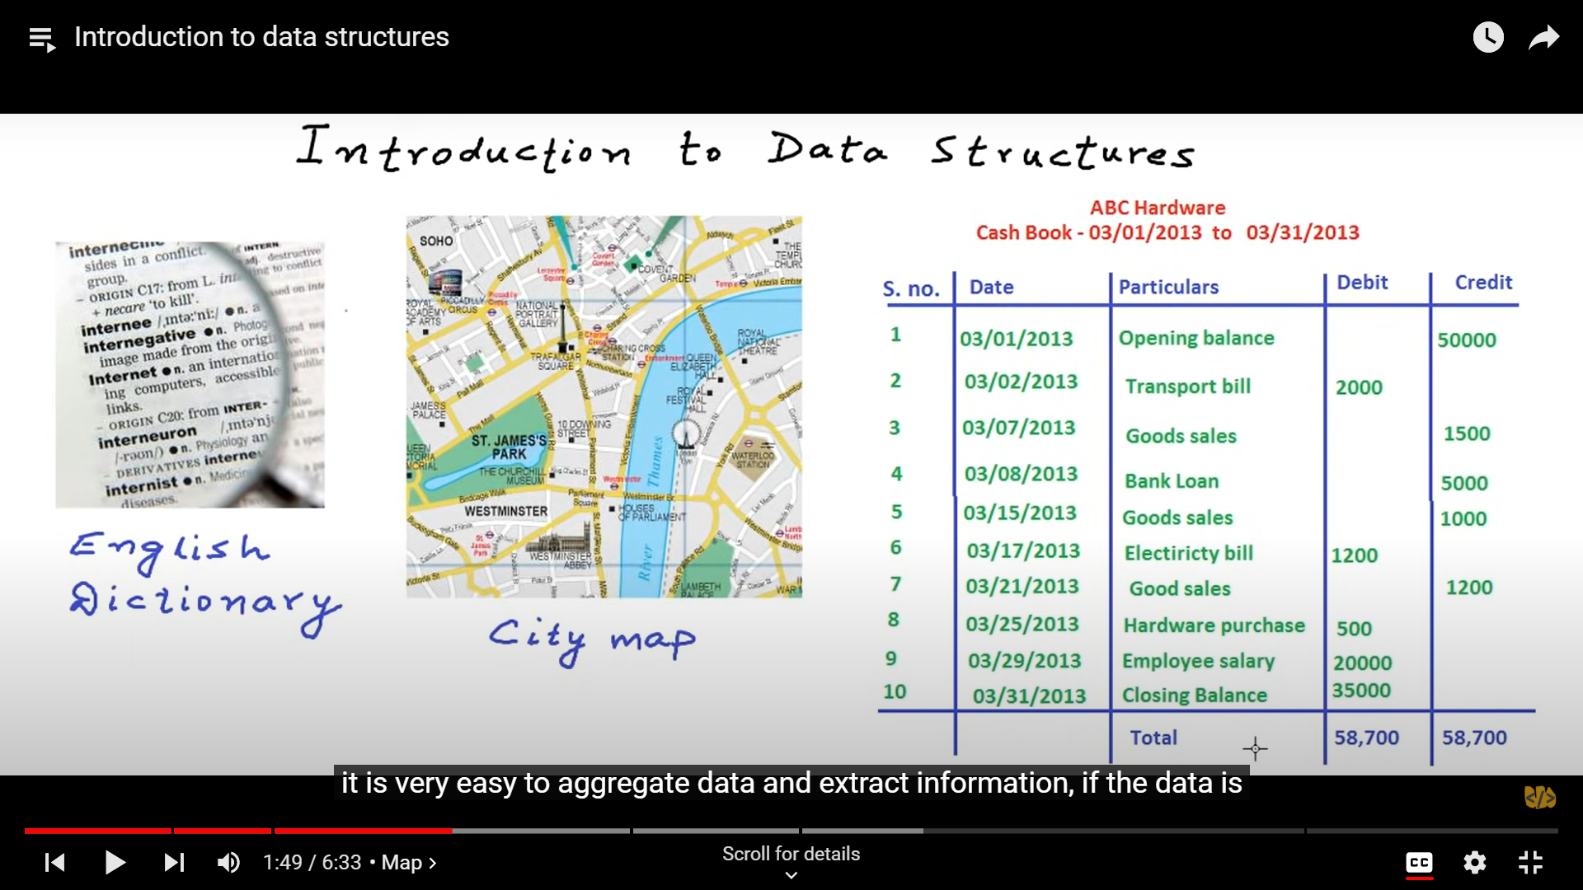

Slide 4
Context of Computing
Input Data
Processing
Output Results
Computer Program
Instructions + Data
Algorithms
Data Structures

Slide 5
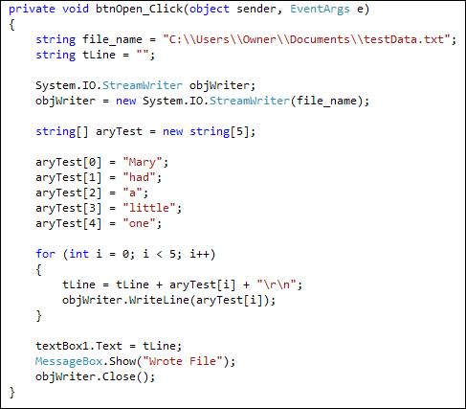
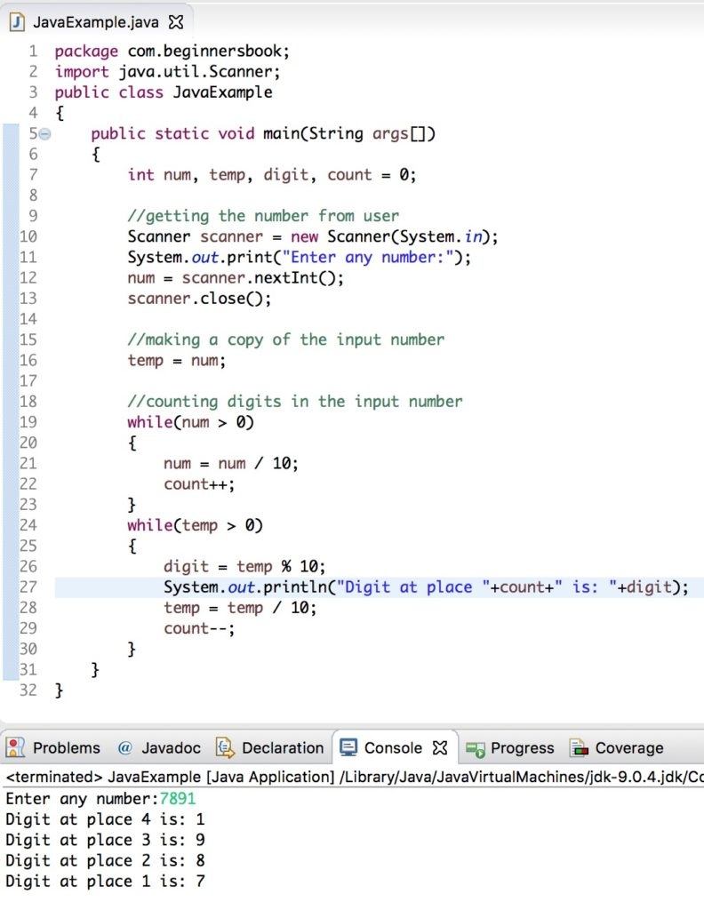
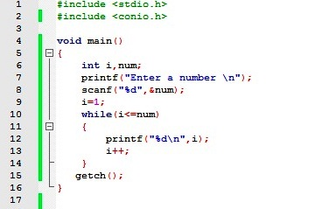

Slide 6
What are data structures?
A program need to store/hold, input, intermediate and output data items.
Programming languages support data storage via
Variables of basic data types
Arrays
Records/structures
More complex data structures can be implemented using the basic data types and other language elements available.
Linked lists
Trees

Slide 7
Examples
int age;
float marks[100];
struct person { char name[20];
int age;
char phone[10]; } nimal;
nimal
name
 |  | …
 |  |  | …
age
age
marks
phone
 |  | …

Slide 8
Data Structures (Cont…)
.
Example: Suppose you are hired to create a database of names with all company's management and employees.

Slide 9
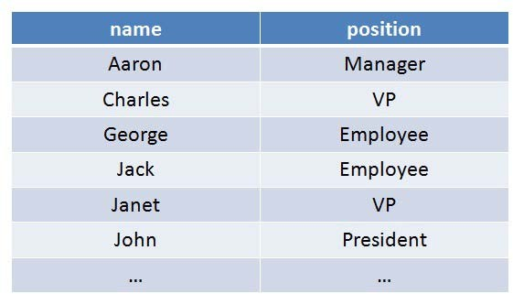
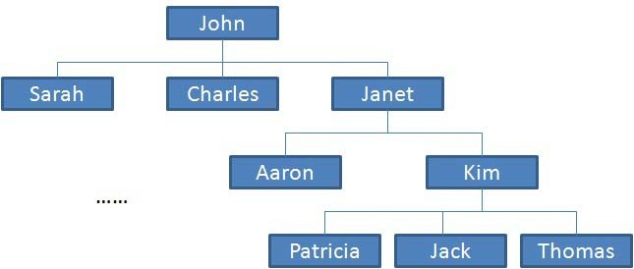
Example of Data Structures
You can make a list. You can also make a tree.

Slide 10
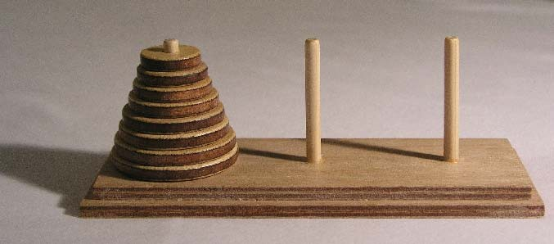
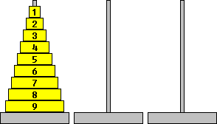
Example of Data Structures (Cont…)
You can use stack data-structure as Hanoi tower.

Slide 11
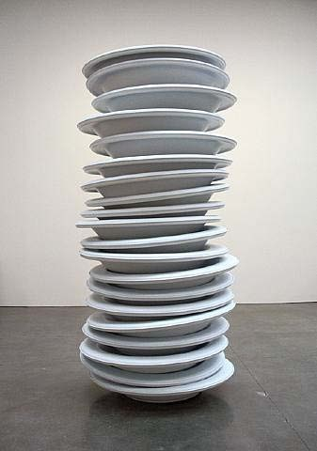
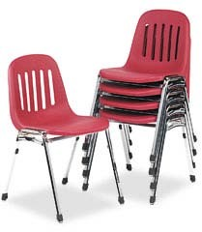

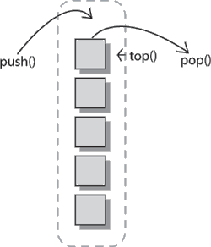
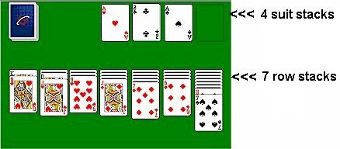
Common Examples Stack

Slide 12
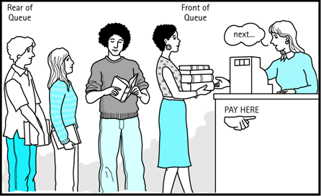
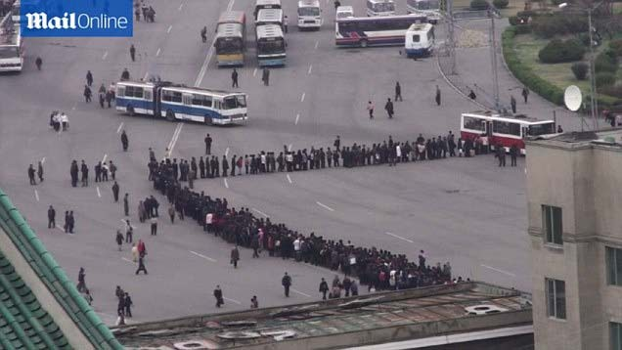
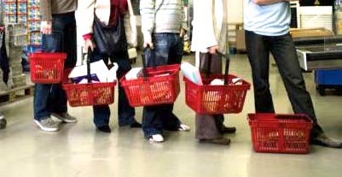
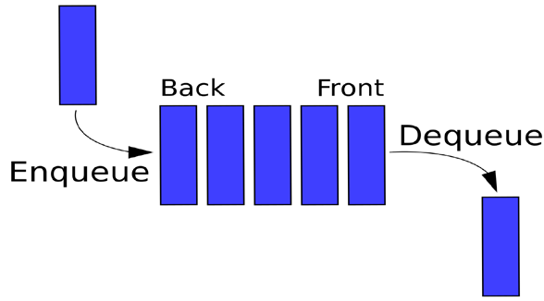

Common Examples Queue

Slide 13
Data Structures Types
There are several common data structures: arrays, linked lists, queues, stacks, binary trees, hash tables, etc.
These data
structures can be classified as
either linear or nonlinear data structures, based on how the data is conceptually organized or aggregated.

Slide 14























Data Structures Classification
Direct Access |  | Array
Linear
List
Data Structures
Sequential Access
Stack (LIFO)
Queue (FIFO)
Trees
Non-Linear
Hash Table
Graphs

Slide 15
Linear Vs Non-Linear Data Structures
Linear Structures | Non-Linear Structures
Array, list, queue, and stack belong to this category. Each of them is a collection that stores its entries in a linear sequence. They differ in the restrictions they place on how these entries may be added, removed, or accessed. Common restrictions include FIFO and LIFO. | Trees and graphs are classical non- linear structures. Data entries are not arranged in a sequence, but with different rules.

Slide 16
Definition: Data Structures
A data structure is systematic way of organizing and accessing data with a specific relationship between the elements.
Why data structures?
Main purpose is to write efficient programs. In order to do that, one needs to organize the data in such a way that it can be accessed and manipulated efficiently.

Slide 17
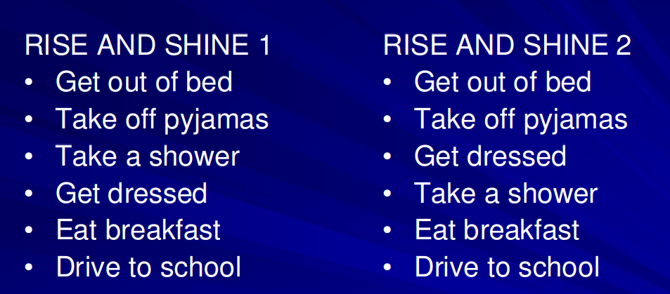

Slide 18
Algorithm
An algorithm is a sequence of computational steps that transform an input into an output.
Example:
Sorting Problem
Input: A sequence of n numbers
Output: A permutation (reordering) of the input sequence

Slide 19
How do you learn algorithms to cook?
To become good chef, you don’t learn lots of recipes by heart.
study existing recipes.
practice making them.
experiment with one’s own variations.
Until one can invent their own recipes.

Slide 20
How do you learn about algorithms?
A good computer scientist doesn’t need to memorize a big book of algorithms:
We will begin studying famous algorithms.
You can practice executing them by hand.
Once you recognize more general patterns, you can
experiment with your own variations.
At the end of the course, invent algorithms yourself.

Slide 21
Algorithms, Programming
A good understanding of algorithms is essential for a good understanding of the most basic element of computer science
i.e. programming.
Unlike a program, an algorithm is a mathematical entity, which is independent of a specific programming language, machine, or compiler.
Thus, in some sense, algorithm design is all about the mathematical theory behind the design of good programs.

Slide 22
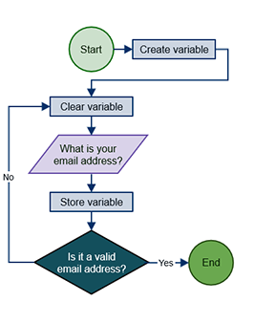
Algorithm

Slide 23
Applications

Slide 24

Questions
24

